Slide 1
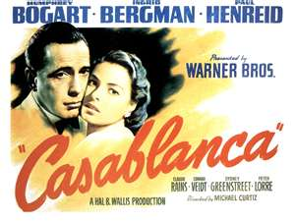
We’ll alw
Casablanca

Slide 2
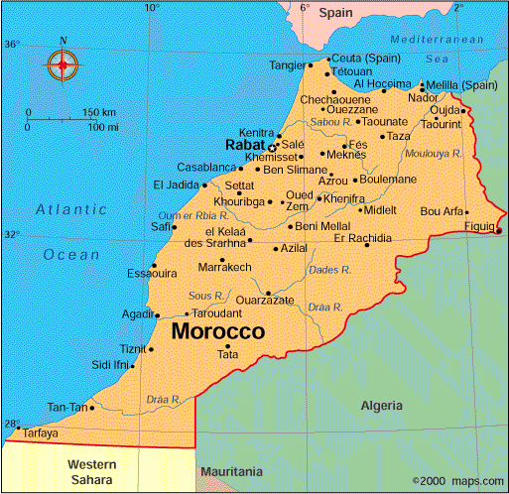
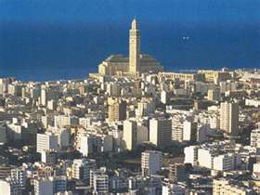

Slide 3
CREDITS
DIRECTOR: Michael Curtiz
SCREENPLAY: Julius Epstein, Phillip Epstein, Howard Koch
Based on a play, “Everybody Comes to Rick’s”

Slide 4
Actors
*Rick Blaine….Humphrey Bogart
*Illsa Lund……Ingrid Bergman
Victor Laslo….Paul Henreid
Captain Louis Renaults…Claude Rains
Major Heinrich Strasser…Conrad Veidt
Signor Ferrari…Sydney Greenstreet
Guillermo Ugarte…Peter Lorre
Sam…Dooley Wilson

Slide 5
Humphrey Bogart
Began in 1930’s
Cast as the anti-hero/reluctant hero
Left his wife for young Lauren Bacall (scandel)
Hollywood icon/legend
Websites devoted to him
http://www.tcm.com/tcmdb/person/18290%7C71928/Humphrey-Bogart/
http://bogart-tribute.net/

Slide 6
Ingrid Bergman
From Sweden
Career spanned 5 decades
Hollywood heartthrob - Selznick's desire to cast her in "wholesome" roles, won her both the adoration of American audiences and an impeccable image that would follow her throughout the 1930s and 1940s.

Slide 7
Casablanca Quotes
“Play it again, Sam!”
“We’ll always have Paris!”
“Here’s looking at you, kid!”
“I think this is the beginning of a beautiful friendship.”

Slide 8
Classic Hollywood
Forward-driving narrative
Love story
Strong, sympathethic characters
Exotic atmosphere
Historical backdrop
A host of stars

Slide 9
Studios owned the players
Writers
Directors
Actors
Technicians
Spacious lots for sets

Slide 10
Quickly put together
Idea approved after attack on Pearl Harbour
Ran overtime and over budget
Release to coincide with Allied troops landing in Morocco

Slide 11
Plot Summarized
Rick’s American past is revealed by a flashback to Paris, where he and Illsa fell in love just before the Germans invaded France, forcing them to leave. When Illsa failed to meet him at the train station, he felt alone, feeling bitter and betrayed, eventually becoming the successful though reclusive owner of Rick’s Café Americain in Casablanca.

Slide 12
In World War II Casablanca, Rick Blaine, exiled American and former freedom fighter, runs the most popular nightspot in town. The cynical lone wolf Blaine comes into the possession of two valuable letters of transit. When Nazi Major Strasser arrives in Casablanca, the sycophantic police Captain Renault does what he can to please him, including detaining Czech underground leader Victor Laszlo. Much to Rick's surprise, Lazslo arrives with Ilsa, Rick's one time love. Rick is very bitter towards Ilsa, who ran out on him in Paris, but when he learns she had good reason to, they plan to run off together again using the letters of transit. Well, that was their original plan....

Slide 13
During World War II, Europeans who were fleeing from the Germans, sought refuge in America. But to get there they would first have to go Casablanca and once they get there, they have to obtain exit visas which are not very easy to come by. Now the hottest spot in all of Casablanca is Rick's Cafe which is operated by Rick Blaine, an American expatriate, who for some reason can't return there, and he is also extremely cynical. Now it seems that two German couriers were killed and the documents they were carrying were taken.

Slide 14
Now one of Rick's regulars, Ugarte entrusts to him some letters of transit, which he intends to sell but before he does he is arrested for killing the couriers. Captain Renault, the Chief of Police, who is neutral in his political views, informs Rick that Victor Laszlo, the European Resistance leader, is in Casablanca and will do anything to get an exit visa but Renault has been "told" by Major Strasser of the Gestapo, to keep Laszlo in Casablanca. Laszlo goes to Rick's to meet Ugarte, because he was the one Ugarte was going to sell the letters to. But since Ugarte was arrested he has to find another way. Accompanying him is Ilsa Lund, who knew Rick when he was in Paris, and when they meet some of Rick's old wounds reopen. It is obvious that Rick's stone heart was because of her leaving him. And when they learn that Rick has the letters, he refuses to give them to him, because "he doesn't stick his neck out for anyone"

Slide 15
Themes
By acting, Rick steps into history
Rick and US before WWII – the same?
Casa Blanca means “white house” equating Ricks coming out of exile to the US involvement in WWII.
Reference to Pearl Harbor – “What time is it in NY? I bet they are all asleep.” Wake up call for US.

Slide 16
Themes contin…
Ricks isolationism = US individualism
Rick is free from entangling allies
Rick’s principled independence makes him so attractive

Slide 17
Casablanca was released in Nov. 1943
Widely released during the Churchill-Roosevelt conference in Casablanca.
Won 3 Oscars: Best Picture, Best Direcotr and Best Screenplay
Considered #2 in the top 100 movies, behind Citizen Kane

