Slide 1
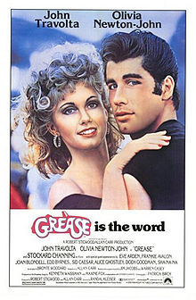
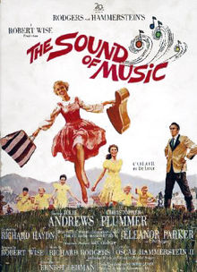
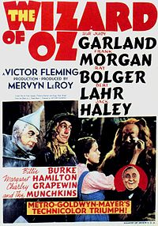
MUSICAL THEATRE
The Wizard of Oz

Slide 2
MUSICALS
A form of theatre that combines songs, spoken dialogue, acting, and dance.
The story and emotional content of the piece – humor, pathos, love, anger – are communicated through the words, music, movement and technical aspects of the entertainment as an integrated whole.
http://www.youtube.com/watch?v=01DMbrhndYA

Slide 3
Why is it unique?
distinguished by the equal importance given to the music as compared with the dialogue, movement and other elements of the works.
modern Western musical theatre emerged during the 19th century
http://www.youtube.com/watch?v=aataTbxlWeM

Slide 4
HISTORY
Musical theatre in Europe dates back to the theatre of ancient Greece where music and dance was included in stage comedies and tragedies during the 5th century BCE

Slide 5
HISTORY
Early in the 20th century, the Princess Theatre musicals and other smart shows like Of Thee I Sing were artistic steps forward beyond revues and other frothy entertainments
Show Boat and Oklahoma!
http://www.youtube.com/watch?v=mrDVzbeDzRk

Slide 6
You may have heard of…
Some of the most famous and iconic musicals through the decades that followed include
West Side Story http://www.youtube.com/watch?v=NPlcE3GcoFc
The Fantasticks
Hair
A Chorus Line
Les Misérables
The Phantom of the Opera
Rent
The Producers
Wicked

Slide 7
Book Musical
"book musical" has been defined as a musical play where songs and dances are fully integrated into a well-made story with serious dramatic goals that is able to evoke genuine emotions other than laughter.
three main components of a book musical are its music, lyrics and book.

Slide 8
Components of Book Musicals
The book of a musical refers to the story, character development, and dramatic structure, including the spoken dialogue but can also refer to the dialogue and lyrics together, which are sometimes referred to as the libretto (Italian for “little book”).

Slide 9
Components…
The music and lyrics together form the score of a musical but the interpretation of a musical by its creative team heavily influences the way in which a musical is presented. http://www.youtube.com/watch?v=PSZxmZmBfnU
That team includes a director, a musical director, usually a choreographer and sometimes an orchestrator.
A musical's production is also creatively characterized by technical aspects, such as set design, costumes, stage properties (props), lighting and sound, which generally change from the original production to succeeding productions.
Some famous production elements, however, may be retained from the original production; for example, Bob Fosse's choreography in Chicago.

Slide 10
Components…
most musicals range from one and a half to three hours.
Musicals are usually presented in two acts, with one short intermission and the first act frequently longer than the second.
The first act generally introduces nearly all of the characters and most of the music, and often ends with the introduction of a dramatic conflict or plot complication
second act may introduce a few new songs but usually contains reprises of important musical themes and resolves the conflict or complication.

Slide 11
Components…
A book musical is usually built around four to six main theme tunes that are reprised later in the show, although it sometimes consists of a series of songs not directly musically related. Spoken dialogue is generally interspersed between musical numbers, although "sung dialogue" or recitative may be used,

Slide 12
Components…
Moments of greatest dramatic intensity in a book musical are often performed in song. When the emotion becomes too strong for speech you sing; when it becomes too strong for song, you dance
there is less time to develop drama in a musical than in a straight play of equivalent length, since a musical usually devotes more time to music than to dialogue

Slide 13
WHERE?
Musicals are performed all around the world.
They may be presented in large venues, such as big budget West End and Broadway theatre productions in London and New York City
smaller fringe theatre, Off-Broadway or regional theatre productions, on tour, or by amateur groups in schools, theatres and other performance spaces.
In addition to Britain and North America, there are vibrant musical theatre scenes in many countries in Europe, Latin America, Australia and Asia.
http://www.youtube.com/watch?v=-0bOH8ABpco&feature=related

