Slide 1
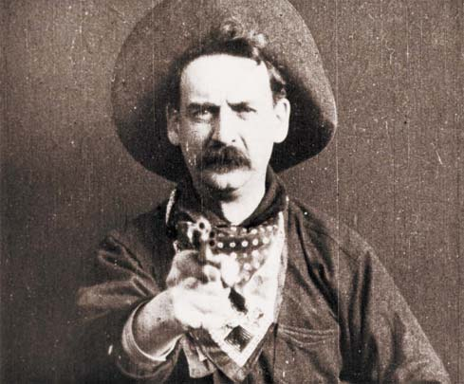
Westerns
http://www.youtube.com/watch?v=Ku4aAhxcbLw&feature=fvsr

Slide 2
Origin of the Western
The Western is a genre of various visual arts, such as film, television, radio, literature, painting and others.
Westerns are devoted to telling stories set primarily in the latter half of the 19th century in the American Old West, hence the name.
Some Westerns are set as early as the Battle of the Alamo in 1836.

Slide 3
Major themes
Westerns often portray how desolate and hard life was for American frontier families.
These families are faced with change that would severely alter their way of life.
conflict between natives and settlers or U.S. Cavalry
conflict between cattle ranchers and farmers ranchers being threatened by the onset of the Industrial Revolution.

Slide 4
Themes
Conquest of the wilderness and the subordination of nature in the name of civilization
Confiscation of the territorial rights of the original inhabitants of the frontier.
Depicts a society organized around private justice rather than one organized around rationalistic, abstract law

Slide 5
Themes
Simple morality tales
Westerns often stress the harshness of the wilderness
Centers on the life of a semi-nomadic wanderer, usually a cowboy or a gunfighter.

Slide 6
Protagonists
Western protagonist are literary descendants of the knight errant which stood at the center of earlier extensive genres such as the Arthurian Romances.
Like the cowboy or gunfighter of the Western, the knight errant of the earlier European tales and poetry was wandering from place to place on his horse, fighting villains of various kinds and bound to no fixed social structures but only to his own innate code of honor.

Slide 7
Protagonists
Like knights errant, the heroes of Westerns frequently rescue damsels in distress.
Similarly, the wandering protagonists of Westerns share many of the characteristics equated with the image of the ronin in modern Japanese culture.

Slide 8
Settings
isolated forts
ranches
homesteads
Native American village
small frontier town with its saloon
general store
livery stable

Slide 9
Setting
It is usually the saloon that emphasizes the "Wild West“
music (raucous piano playing)
women (often prostitutes)
gambling (draw poker or five card stud)
drinking (beer or whiskey)
brawling and shooting.

Slide 10
Setting
In some Westerns, where "civilization" has arrived, the town has a church and a school
In others, where frontier rules still hold fast, it is, "where life has no value".

Slide 11
Characteristics
Western films were enormously popular in the silent era
Western films often depict conflicts with Native Americans.
-frequently portray the "Injuns" as dishonorable villains
-later those directed by John Ford gave native Americans a more sympathetic treatment

Slide 12
Filming
Early Westerns were mostly filmed in the studio, just like other early Hollywood films
Location shooting became more common from the 1930s,
Producers used desolate corners of Arizona, California, Colorado, Kansas, Montana, Nevada, New Mexico, Oklahoma, Texas, Utah, or Wyoming.
Productions were also filmed on location at movie ranches.

Slide 13
Setting
The vast landscape becomes more than a vivid backdrop; it becomes a character in the film.
After the early 1950s, various wide screen formats such as cinemascope (1953) and VistaVision used the expanded width of the screen to display spectacular Western landscapes.
Mythic vision of the plains and deserts of the American West

Slide 14
Classic Western
The first Western film was the 1903 film The Great Train Robbery, a silent film
The Golden Age of the Western film is epitomized by the work of two directors: John Ford and Howard Hawks (both of whom often used John Wayne in lead roles). http://www.youtube.com/watch?v=tN-j4GDqjv4
http://www.youtube.com/watch?v=0EUP9rOLf30

Slide 15
Spaghetti Westerns
During the 1960s and 1970s, a revival of the Western emerged in Italy with the "Spaghetti Westerns" or "Italo-Westerns".
The Good, the Bad, and the Ugly. http://www.youtube.com/watch?v=yjDBUL_zhqs&feature=fvst
Low-budget affairs
Shot in locations
Characterized by the presence of more action and violence than the Hollywood Westerns
Protagonists usually acted out of more selfish motives (money or revenge being the most common) than in the classical westerns.

Slide 16
Revisionist Westerns
After the early 1960s, many American film-makers began to question and change many traditional elements of Westerns
increasingly positive representation of Native Americans who had been treated as "savages" in earlier films (Little Big Man, Dances with Wolves).
Audiences were encouraged to question the simple hero-versus-villain dualism and the morality of using violence to test one's character or to prove oneself right. http://www.youtube.com/watch?v=d9ICbZVs9TU

Slide 17
Revisionist-Women
Some recent Westerns give women more powerful roles.
1956 adventure film The Last Wagon in which Richard Widmark played a white man raised by Comanches and persecuted by http://www.youtube.com/watch?v=wKONbMyZU- http://www.youtube.com/watch?v=wKONbMyZU-o
Westward the Women (1951) starring Robert Taylor is another example.

Slide 18
Contemporary Westerns
Old West themes and motifs (a rebellious anti-hero, open plains and desert landscapes)
Take place in the American West and reveal the progression of the Old West mentality
Old West-type characters struggling with displacement in a "civilized" world that rejects their outdated brand of justice.
Brokeback Mountain (2005); No Country For Old Men (2007). Tales of the Texas Rangers, a contemporary detective drama set in Texas, featuring many of the characteristics of traditional Westerns.

Slide 19
Contemporary Westerns
Old West-type characters struggling with displacement in a "civilized" world that rejects their outdated brand of justice.
Brokeback Mountain (2005); No Country For Old Men (2007). Tales of the Texas Rangers, a contemporary detective drama set in Texas, featuring many of the characteristics of traditional Westerns.
http://www.youtube.com/watch?v=YBqmKSAHc6w

